Slide 1
Training Deep Neural Networks
Jordan Montgomery
July 22, 2020
Notes:
1
1
Check distro statement before using:
DISTRIBUTION STATEMENT A. Approved for pubic release: distribution is unlimited.
This material is based upon work supported under Air Force Contract No. FA8721-05-C-0002 and/or FA8702-15-D-0001. Any opinions, findings, conclusions or recommendations expressed in this material are those of the author(s) and do not necessarily reflect the views of the U.S. Air Force.
© 2020 Massachusetts Institute of Technology.
Delivered to the U.S. Government with Unlimited Rights, as defined in DFARS Part 252.227-7013 or 7014 (Feb 2014). Notwithstanding any copyright notice, U.S. Government rights in this work are defined by DFARS 252.227-7013 or DFARS 252.227-7014 as detailed above. Use of this work other than as specifically authorized by the U.S. Government may violate any copyrights that exist in this work.

Slide 2
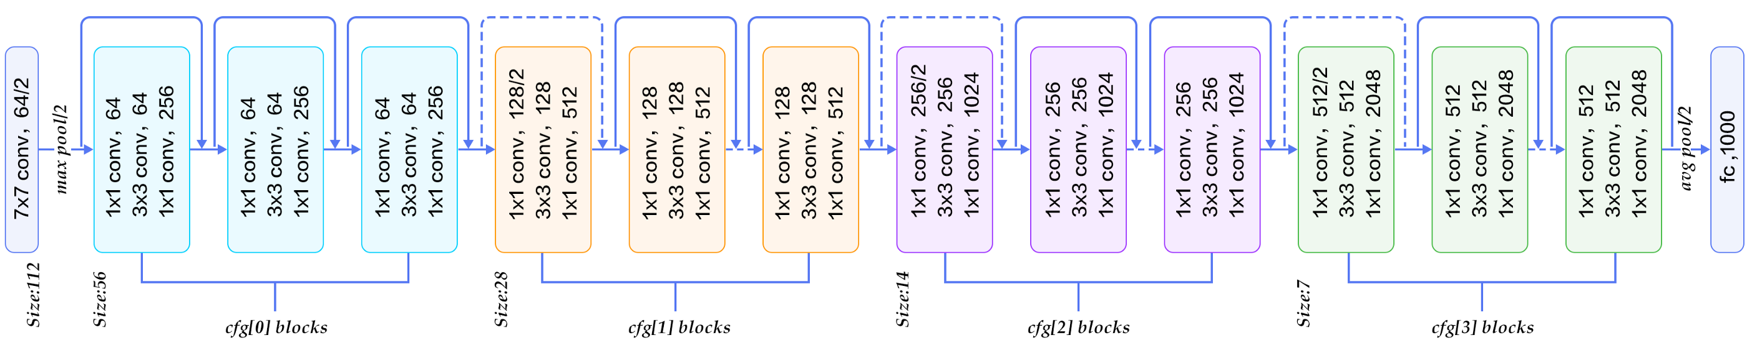
Deep Learning Problems
Increasingly Abstract
I nput
Loss
Backpropagation from Loss Function
Problem 1: Overfitting
Many parameters available
Tremendous data requirements
Problem 2: Vanishing Gradient
Difficult to train first layers
Stalls most training efforts
Training very deep networks often limited by data requirements and vanishing gradients
Several innovative solutions to these problems over past decade

Slide 3
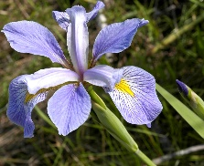
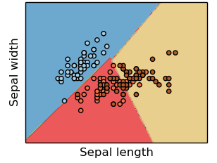
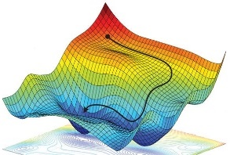
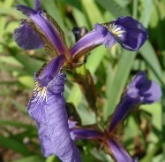
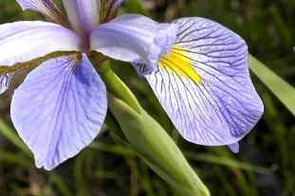
Necessary Components of a Supervised Machine Learning Approach
Training Data
Feature
Selection
Cost Function
Training Algorithm
Model Type
p
s
IrVi
IrSe
Set of labeled example data
Method to select data characteristics critical information
The form of model which will be trained to make decisions
Metric by which a prospective models should be judged
Algorithm to minimize the cost function by tuning model parameters
Description
- Tabular data
- Time-series
- Images
- Videos
- ASCII text
- Intuition
- Expert knowledge
- Statistics
- Learned features
- Regression
- Nearest neighbor
- Decision tree
- SVM
- Neural Network
- Squared error
- Absolute error
- Cross-entropy
- Accuracy
- Gradient descent
- Gradient-free opt.
- Analytic solution
Examples
Supervised machine learning approaches require each of these components
* image sources: scikit-learn (for “model type”) and https://reconsider.news/2018/05/09/ai-researchers-allege-machine-learning-alchemy (for “training algorithm”)

Slide 4
Necessary Components of a Supervised Machine Learning Approach
Training Data
Feature
Selection
Cost Function
Training Algorithm
Model Type
p
s
IrVi
IrSe
Set of labeled example data
Method to select data characteristics critical information
The form of model which will be trained to make decisions
Metric by which a prospective models should be judged
Algorithm to minimize the cost function by tuning model parameters
Description
- Tabular data
- Time-series
- Images
- Videos
- ASCII text
- Intuition
- Expert knowledge
- Statistics
- Learned features
- Regression
- Nearest neighbor
- Decision tree
- SVM
- Neural Network
- Squared error
- Absolute error
- Cross-entropy
- Accuracy
- Gradient descent
- Gradient-free opt.
- Analytic solution
Examples
Focus
Focus
Supervised machine learning approaches require each of these components
* image sources: scikit-learn (for “model type”) and https://reconsider.news/2018/05/09/ai-researchers-allege-machine-learning-alchemy (for “training algorithm”)

Slide 5
Outline
Introduction
Training Deep Networks
Overfitting
Vanishing Gradients
Transfer Learning
Summary

Slide 6
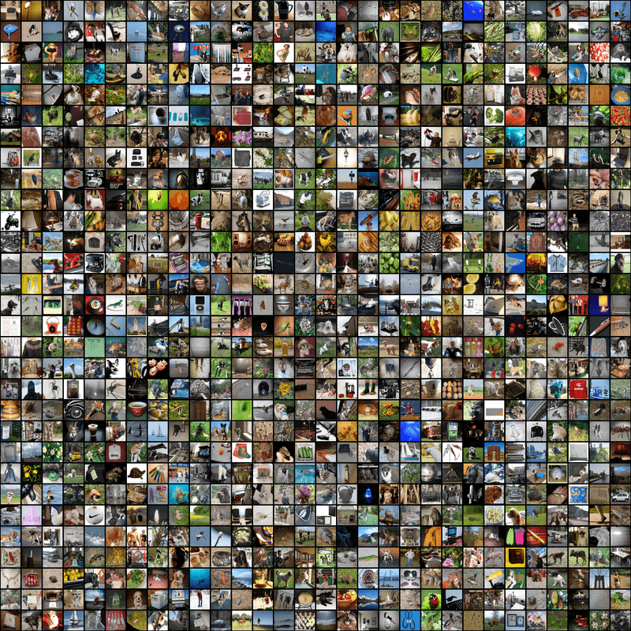
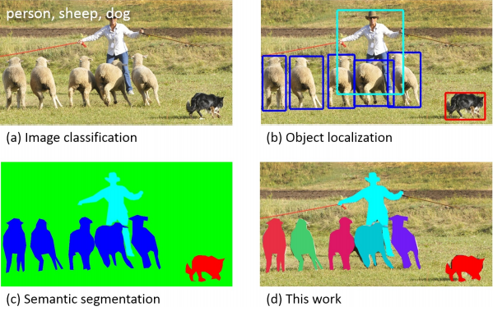
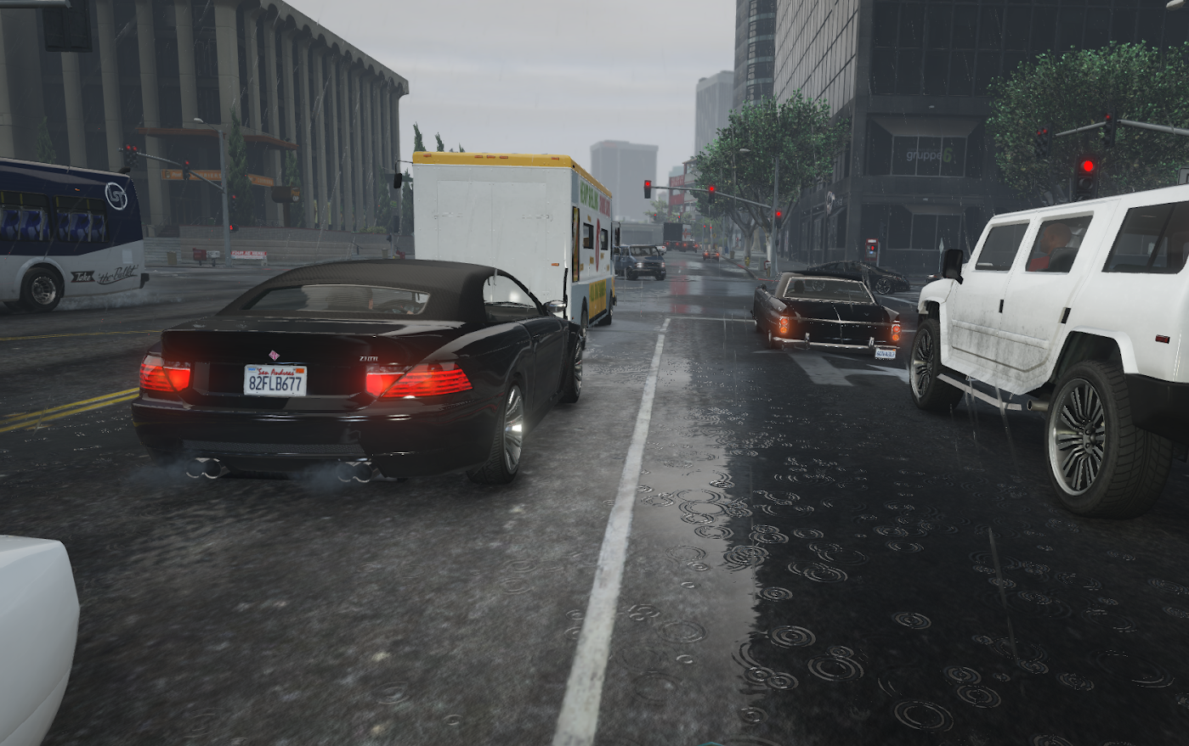
Large Training Datasets
Common Objects in Context (COCO)
ImageNet
Simulated Data(?)
Now at ~14 million labeled images
20,000 categories
Image recognition
Now at ~2,500,000 labeled objects
328,000 unique images
Learning with context
Many simulators available
Can even use games
Often runs into difficulty
Active area of research

Slide 7
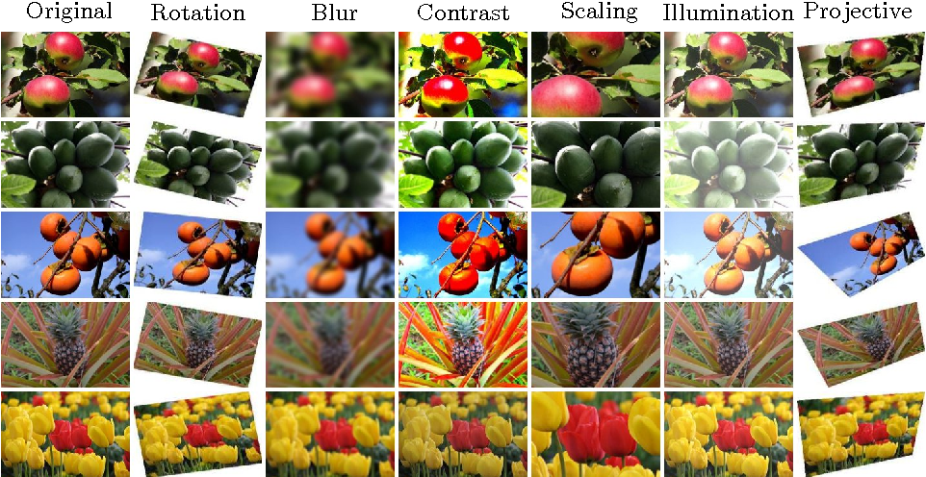
Data Augmentation
Applying random image transformations to training examples effectively increases the amount of training data

Slide 8
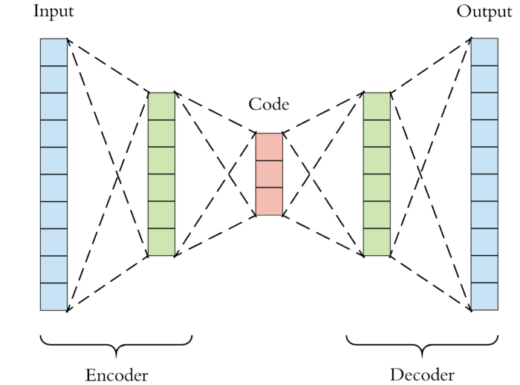
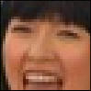
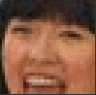
Training an Auto-Encoder
Objective: Learn deconstruct and reconstruct the input image
Requirements: Must transform data into “feature space” before reconstructing image estimate
Loss Function: Difference between original and reconstructed image
Benefit: No image labels required
Yields: Network to transform images into features
Notes:
Check out this nice tutorial on autoencoders: https://stackabuse.com/autoencoders-for-image-reconstruction-in-python-and-keras/

Slide 9
Training an Auto-Encoder
Objective: Learn deconstruct and reconstruct the input image
Requirements: Must transform data into “feature space” before reconstructing image estimate
Loss Function: Difference between original and reconstructed image
Benefit: No image labels required
Yields: Network to transform images into features
Notes:
Check out this nice tutorial on autoencoders: https://stackabuse.com/autoencoders-for-image-reconstruction-in-python-and-keras/

Slide 10
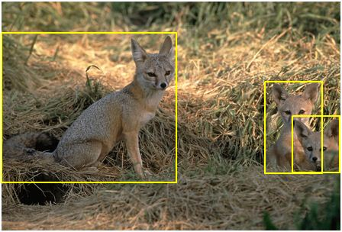
Question
The 2019 version of the ImageNet dataset contains 14,197,122 images. Each image has been labeled with one out of 20,000 possible classifications. Bounding boxes have been generated for objects within 1,034,908 of those images (see example). If each image label required 20 seconds of manual labor, each bounding box required 30 seconds of time, and there are an average of 3 bounding boxes per image, approximately how many years of manual labor were required to produce the ImageNet labels and bounding boxes?
1.95 years
11.95 years
111.95 years
6.35 years

Slide 11
Question
The 2019 version of the ImageNet dataset contains 14,197,122 images. Each image has been labeled with one out of 20,000 possible classifications. Bounding boxes have been generated for objects within 1,034,908 of those images (see example). If each image label required 20 seconds of manual labor, each bounding box required 30 seconds of time, and there are an average of 3 bounding boxes per image, approximately how many years of manual labor were required to produce the ImageNet labels and bounding boxes?
1.95 years
11.95 years
111.95 years
6.35 years

Slide 12
Question
If you were to pay some workers the federal minimum wage ($7.25/hr) to generate these image labels and bounding boxes, how much would it cost for you to finance the creation of the ImageNet dataset?
(Reminder: Our estimate was that ImageNet required 11.95 years worth of manual labor)
$759,000
$866,000
$3,164,000
$86,000,000

Slide 13
Question
If you were to pay some workers the federal minimum wage ($7.25/hr) to generate these image labels and bounding boxes, how much would it cost for you to finance the creation of the ImageNet dataset?
(Reminder: Our estimate was that ImageNet required 11.95 years worth of manual labor)
$759,000
$866,000
$3,164,000
$86,000,000

Slide 14
Outline
Introduction
Training Deep Networks
Overfitting
Vanishing Gradients
Transfer Learning
Summary

Slide 15
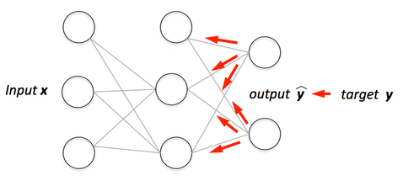
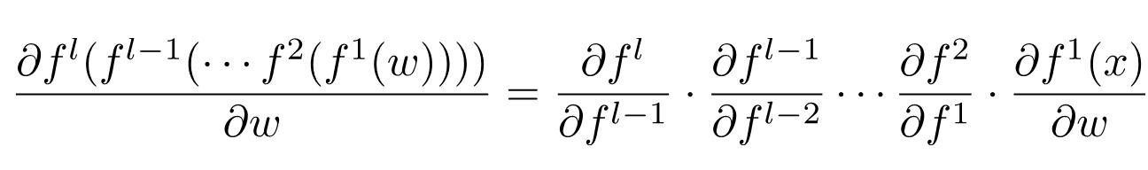
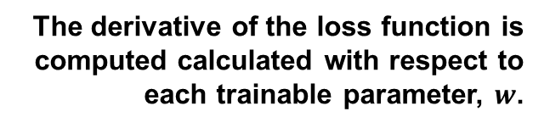
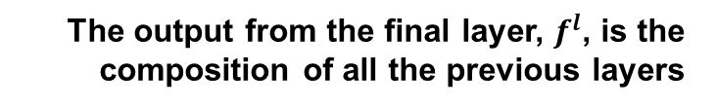
Backpropagation and Gradients
Information is communicated from loss function to previous layers
The derivative of the loss function is computed calculated with respect to each trainable parameter, $w$.
The output from the final layer, $f^{l}$, is the composition of all the previous layers
The Chain Rule indicates this derivative will be zero if the derivative of any of the deeper layers is zero

Slide 16
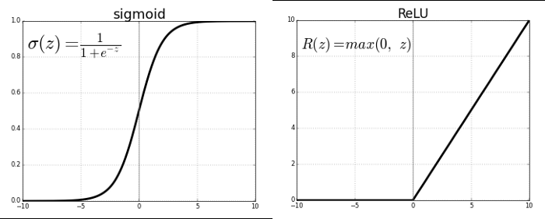
Gradients and Activation Layers
• Some activation functions have small gradients for large input values
Gradient goes to zero at large or small values
Gradient remains finite at large values
Using ReLU activation prevents small gradient sat large activations
Good filter initialization can reduce neuron “death” for negative input values

Slide 17
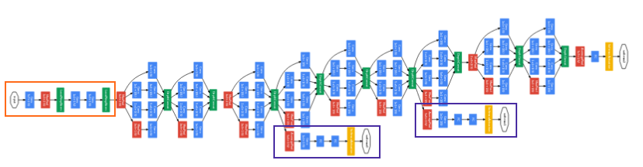
GoogLeNet: An Inception Network
• Key Technique: 1x1 Convolution • Key Concept: Wide not Deep • Still 22 Layers Deep
Inception Networks are Many Filters “Wide”
Inception modules mitigate vanishing gradients placing filters in parallel rather than serial

Slide 18
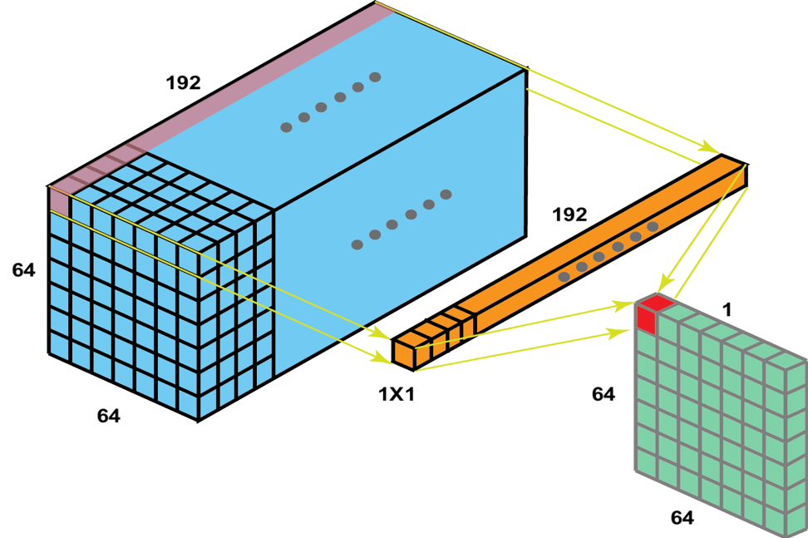
The 1x1 Convolution
1x1 convolution combines content from all feature maps
Feature maps from Conv. Layer with 192 kernels
Significantly reduces dimensionality of feature maps
The 1x1 convolution helps prevent overfitting by keeping the feature space simple

Slide 19
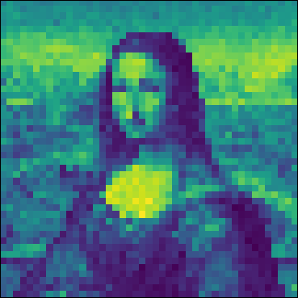
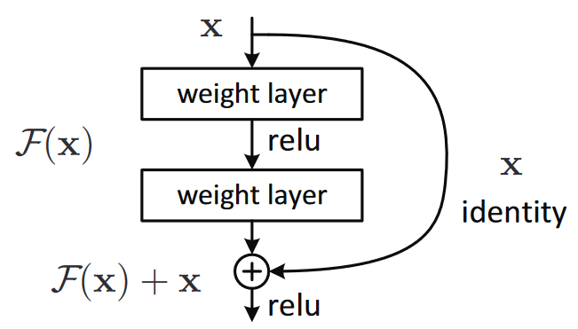
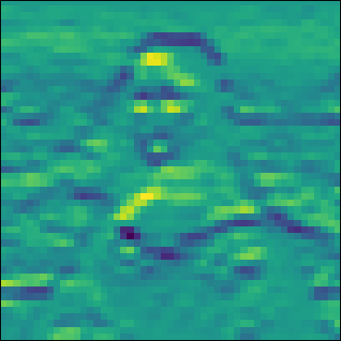
Residual Networks
• Key Technique: Skip Connection
• Key Concept: Learn Filters to get Residual (not whole convolution)
Convolved images are often quite similar to original image
ResNet filters only need to learn how to produce the small difference or “residual”
Values feeding into activation layers remain small (avoid regions with zero-gradient)
Previous Layer
Convolution Output

Slide 20
Outline
Introduction
Training Deep Networks
Transfer Learning
Summary

Slide 21
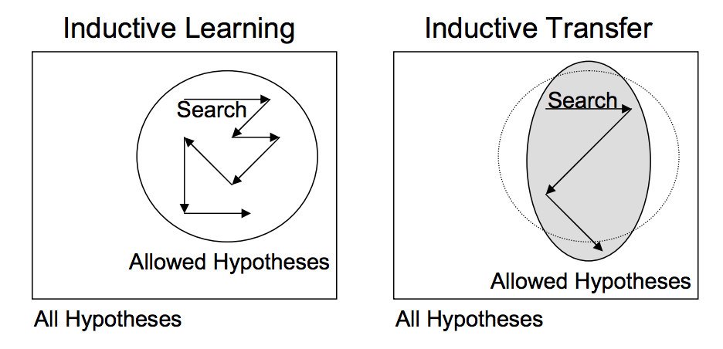
Transfer vs. Inductive Learning
Transfer learning attempts to leverage knowledge gained from one problem and apply it to a similar problem

Slide 22
Transferring Layers to a New Neural Network
Original Classifier
New Classifier
3. Fine-tune classifier on new training data for new problem
Flatten
Flatten
1. Pre-train filter weights using one of aforementioned techniques
MaxPool2D
MaxPool2D
Conv2D
Conv2D
Conv2D
Conv2D
MaxPool2D
2. Transfer learned weights to new network
MaxPool2D
Conv2D
Conv2D
Conv2D
Conv2D
Input Data
Different Input Data

Slide 23
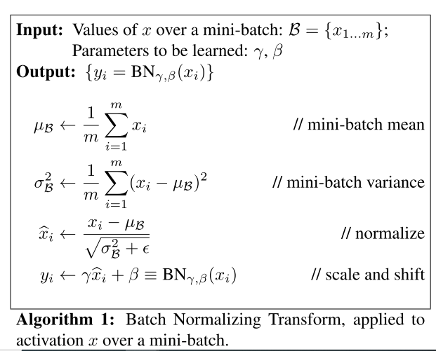
Freezing Layers and Batch Normalization
Freezing Layers
Batch Normalization Layers
New Classifier
Flatten
MaxPool2D
Conv2D
It may be better to leave these filters static during fine-tuning
(experimentation required)
Conv2D
MaxPool2D
Conv2D
Conv2D
Special care must be taken with BatchNorm
Layer “trainable” attribute
“Training mode” vs “Inference mode”
These are linked in TensorFlow 2.0
Different Input Data

Slide 24
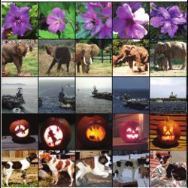
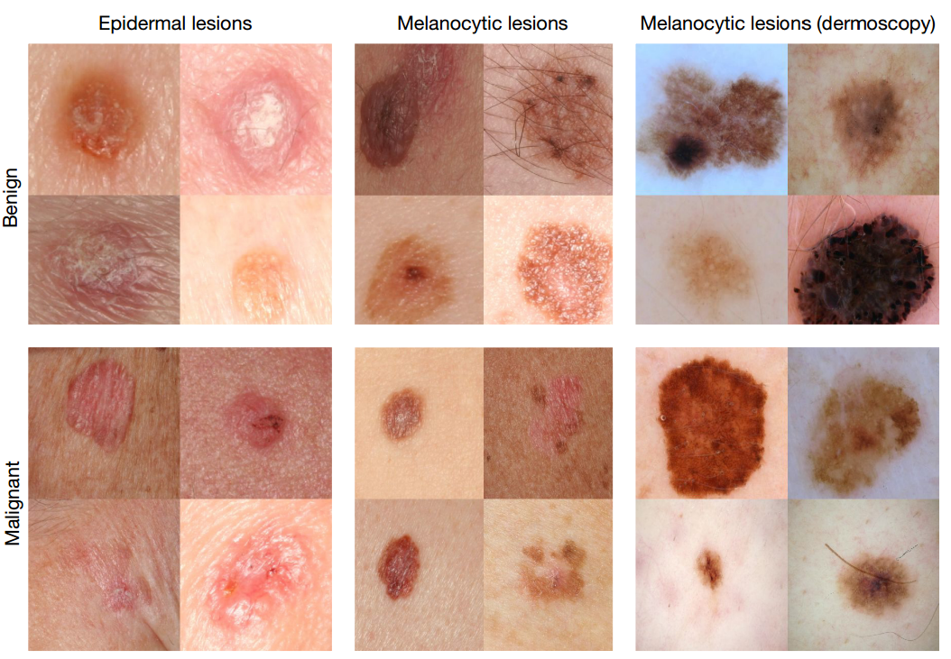
Cross Domain Concerns
Do These Help You Learn About…
…these?
Dissimilarity between pre-training and fine-tuning datasets may cause problems
Filters learned in pre-training may not capture relevant features for new problem

Slide 25
Summary
Most direct way to prevent overfitting is to have an enormous dataset
Some training sets publicly available
Use data augmentation on training set
Potentially train auto-encoder if large database without labels is available
Novel techniques to avoid vanishing gradients during training
ReLU activation (and related family of activations)
Residual/Inception Networks
Training a deep network without an enormous dataset
Transfer learning from pre-trained CNN
Continue data augmentation
Still may run into cross-domain concerns

Slide 26

